Slide 1
Week 2 Updates: SolidWorks DFM Plug-In
Ruoyu Song
Dr. Cassandra Telenko
Aniruddh Marellapudi

Slide 2
Updates from Week 2
Programmed, compiled, and installed simple SolidWorks add-in
Learned concepts in Visual C# and XML
Learned how to use Microsoft Visual Studio
Used custom SolidWorks API to add more functionality (demo)
Custom Properties Editor
Object/feature/dimension Selection

Slide 3
Tremendous Knowledge Base for SolidWorks Plug-In Design
Luke Malpass (AngelSix) has made his own easy-to-use, custom SolidWorks API
Code is licensed under the MIT license, so we can use and distribute
GitHub: https://github.com/angelsix/solidworks-api
Youtube: https://www.youtube.com/playlist?list=PLrW43fNmjaQVMN1-lsB29ECnHRlA4ebYn
Contact: http://www.angelsix.com/

Slide 4
Plug-In Install Procedure
Download AngelSix SolidWorks Add-in Installer
https://www.fasetto.com/folder/preview/c4a975082af24ce6b50ab6a1a7543879
(Disclaimer: Intended for 64-bit Windows and SolidWorks installations)
Enable <loadFromRemoteSources> in machine.config
%windir%\Microsoft.NET\Framework64\[version]\config\machine.config
Open SolidWorks, and find plug-in to the right
Can debug through visual studio with an external instance of SolidWorks

Slide 5
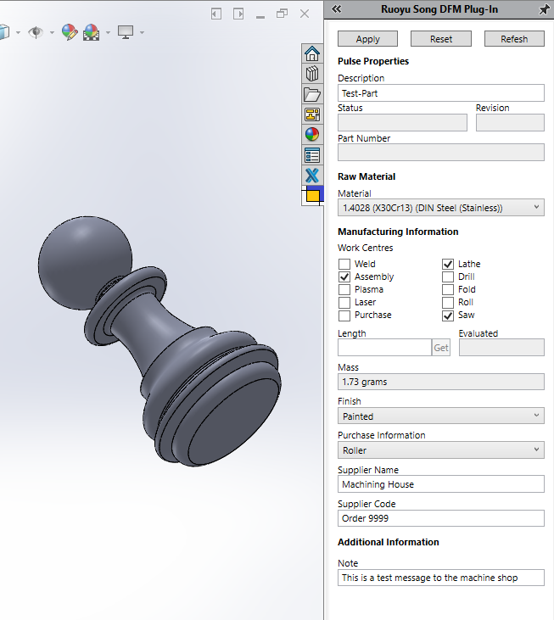
Demo

Slide 6
Next Steps
Design desired interface (sketch/draw)
Define functionality
Export as .STL or .SLDPRT from plug-in
Interface with SculptPrint
Create Python script to automate this

Slide 7
Quick Project Decisions
Choose file hosting methodology (Google Drive, GitHub, DropBox)
Need a proper name and description to display in SolidWorks

Slide 8
Problems List and Solution
AngelSix Add-In Installer returns with an error
The add-in installer runs RegAsm.exe to register your plug-in’s .dll
Can debug manually
cd C:\Windows\Microsoft.NET\Framework64\v4.0.30319
RegAsm.exe /codebase "C:\Users\Aniruddh\Desktop\solidworks-api-develop\Tutorials\DynamicReload\DynamicReload\bin\Debug\DynamicReload.dll"

Slide 9
Problems List and Solution (Cont’d)
Packages downloaded from GitHub do not compile because Dna.Framework is not a valid namespace
Dna.Framework, also written by AngelSix, is a NuGet package
NuGet is a free, open-source package manager in Visual Studio
Make sure this package is properly installed (with dependencies) for each solution

Slide 10
Problems List and Solution (Cont’d)
Make sure SolidWorks Interop files (SolidWorks Native API) have the same version as those referenced by AngelSix API
AngelSix API uses .NET Framework 4.7.1, so make sure this is consistent with your solution

